Slide 1



A CHALLENGE FOR STATISTICIANS:
THE DESIGN-BASED SPATIAL
INTERPOLATION
Lorenzo Fattorini
University of Siena (Italy)
Neuchâtel, 20-22 August 2018

Slide 2

THE GOAL :
rephrasing some issues of spatial statistics - especially
spatial prediction – in a design-based framework

Slide 3
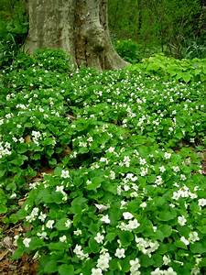
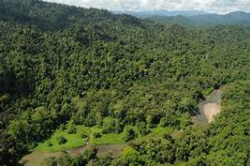
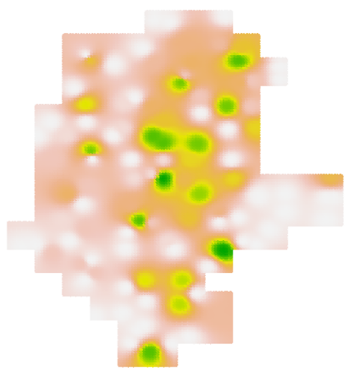
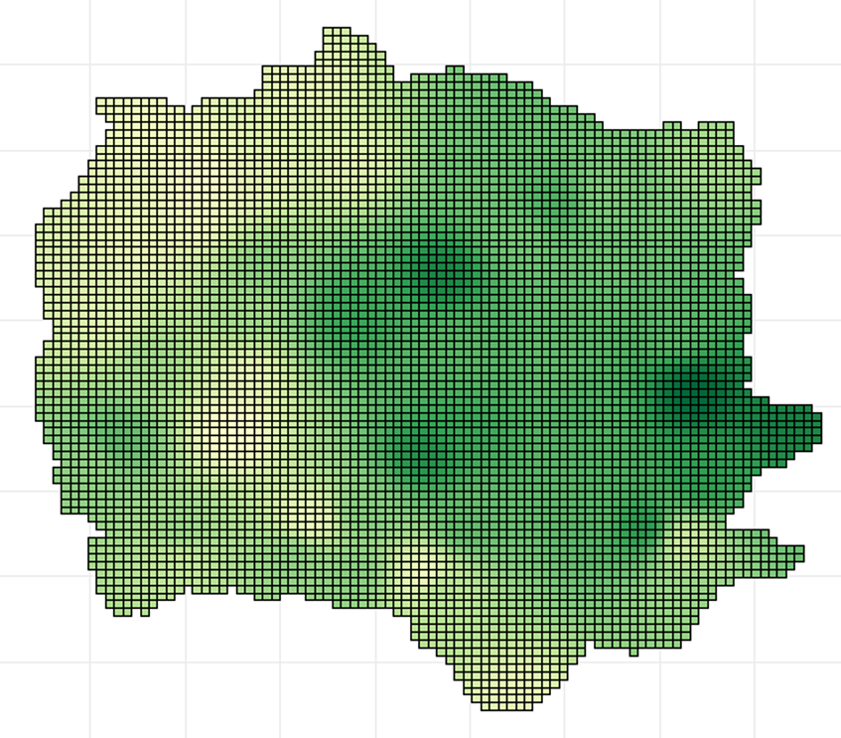
spatially explicit estimates are needed in many environmental and ecological applications for making maps depicting the spatial distribution of attributes
white violet
coverage
wood volume m³

Slide 4
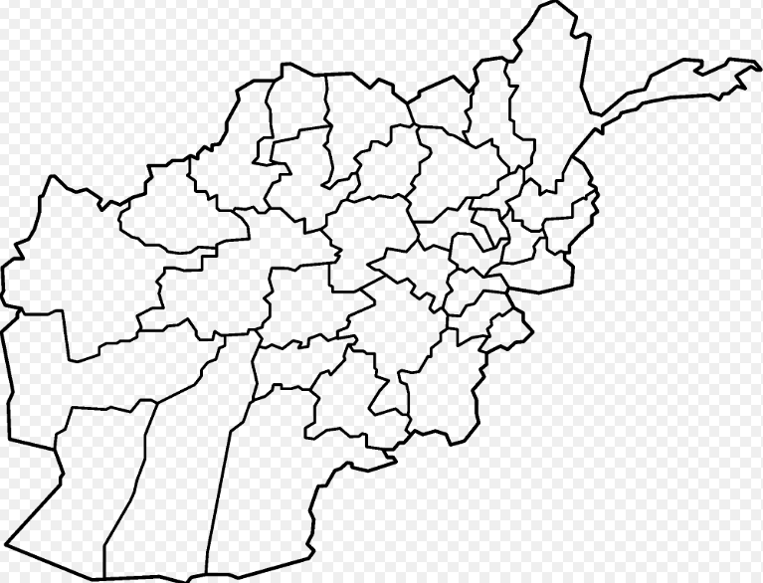
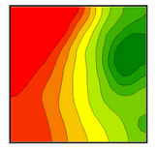
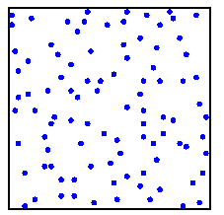
we consider three situations in which
maps can arise:
finite populations of spatial
units
2) continuous populations
3) point populations

Slide 5
STEP 1

Slide 6

we have first considered situations in which:
i) the study region is partitioned into a
finite population of spatial units
ii) the survey variable is the amount of
an attribute within units

Slide 7
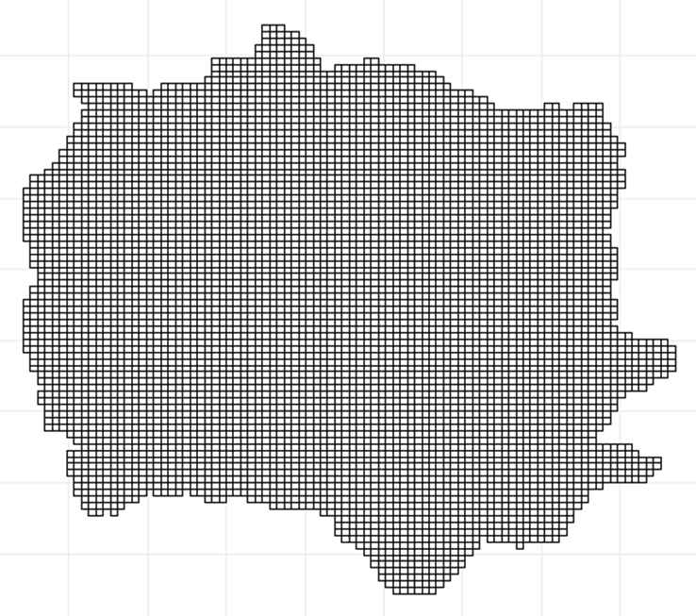
for example …
a network of regular polygons (quadrats)
as frequently happens in forest inventories
or …
a collection of irregular patches such
as administrative districts

Slide 8
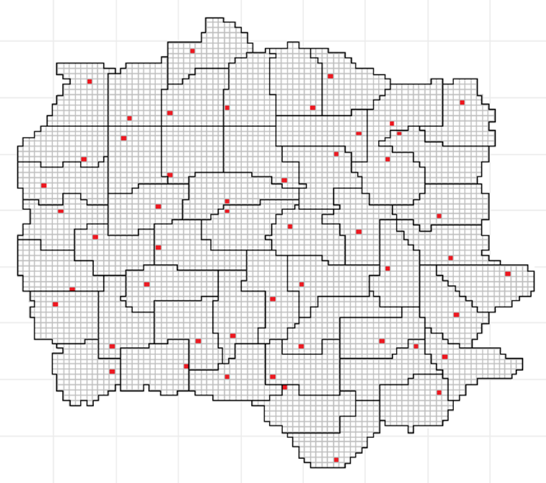
the survey variable is recorded only for a sample of spatial units
a criterion is adopted to estimate the values of the survey variable within non-sampled units …

Slide 9
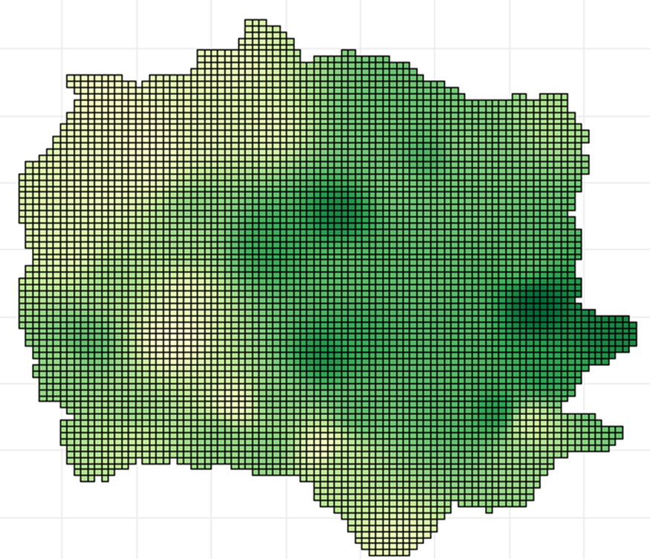
… to obtain wall-to-wall maps depicting the spatial pattern of the survey variable throughout the whole study area

Slide 10
most methods adopted to provide maps for finite populations of spatial units lie in the realm of model-dependent inference
the most common techniques are spatial models on lattices such as:
simultaneously specified gaussian models
conditionally specified gaussian models
(e.g. Cressie 1993, Chapter 6)

Slide 11
we have attempted to make maps in a design-based framework
… population values are viewed as fixed constants and the probability distribution of any sample statistic is determined from the uncertainty entailed by the probabilistic sampling scheme adopted to select the spatial units

Slide 12
the idea of making maps in a design-based framework is challenging
when estimating the value of a single unit, either the unit is sampled and there is no need for estimation …
?
… or the unit is unsampled
and we have no information
about it to perform estimation
the use of an assisting model to estimate unsampled values on the basis of auxiliary information seems to be the sole way to fill the information vacancy

Slide 13
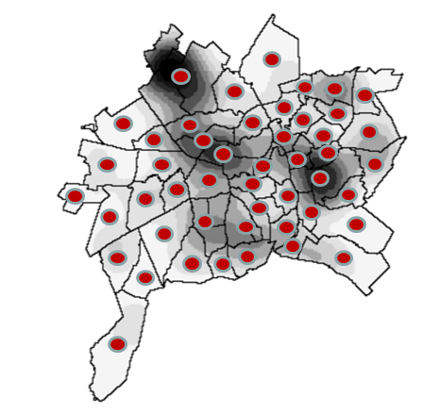
we have focused on an assisting model exploiting the information provided from space
i.e.
the unit locations

Slide 14
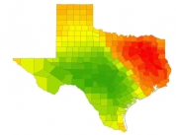
the idea of making design-based maps on the basis of the spatial information is not our
it has been pursued in the pioneering papers by Bruno et al. (2013) and Vagheggini et al. (2016)
the assisting model is the simple
Tobler’s law of geography
i.e.
units that are close in space tend to be more similar than units that are far apart (Tobler, 1970)

Slide 15
on the basis of this principle the authors adopt the inverse distance weighting (IDW) interpolator in which the values of the unsampled units are estimated by a weighted sum of the sample values with weights inversely decreasing with the distances to the units under estimation
sampled
unsampled
but ...

Slide 16
when estimating the value of a single unit
there is no way to correct the error invariably provided by the model prediction
any model-assisted estimator of a single population value is destined to be design-biased
?
?
the whole map is design-biased !!

Slide 17
one way to render statistically sound a model-assisted map is to determine the conditions ensuring some sort of
design-based asymptotic unbiasedness and consistency
DBAU&C

Slide 18
statement of the problem

Slide 19

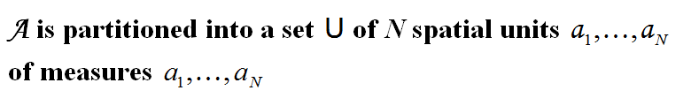

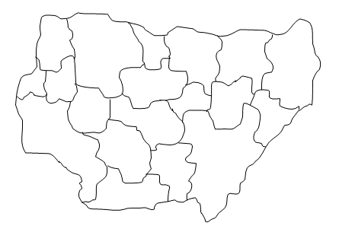
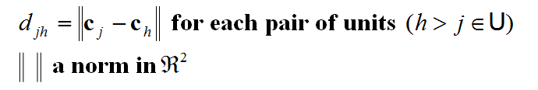

Slide 20

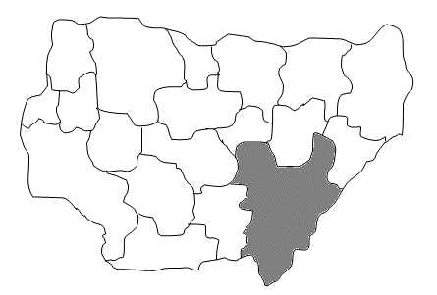
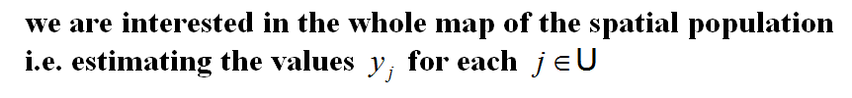

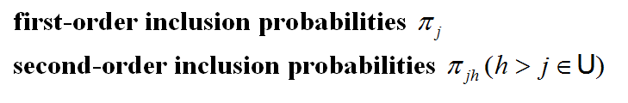
j

Slide 21
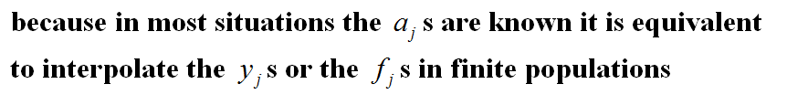

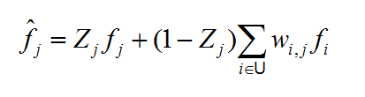

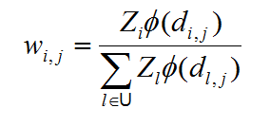

Slide 22


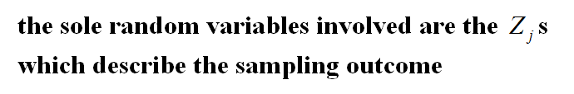

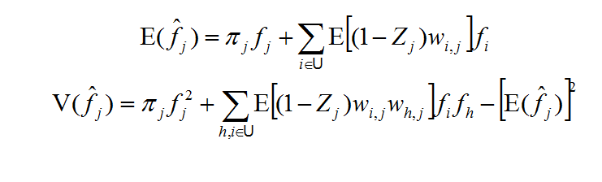
?

Slide 23
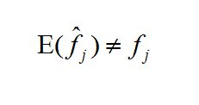


bias
how much ????
precision ????????
no general result about bias
and variance is available
investigations are needed for …
DBAU&C

Slide 24
asymptotic framework

Slide 25
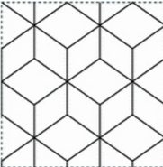

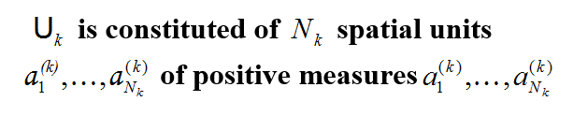
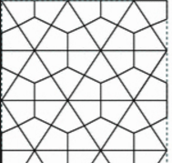

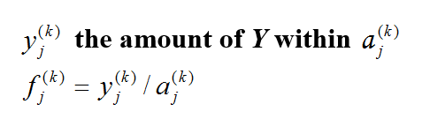
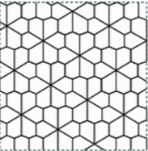
●
●
●

Slide 26


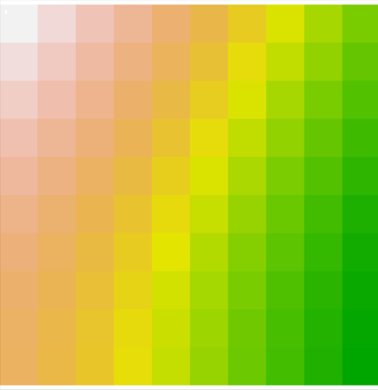
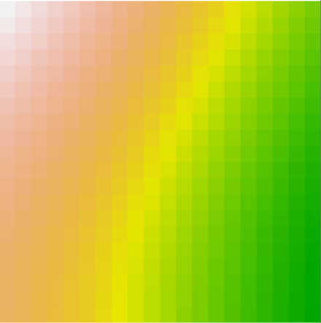
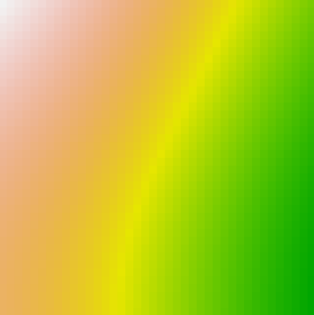
● ● ●
100 quadrats
400 quadrats
1600 quadrats

Slide 27
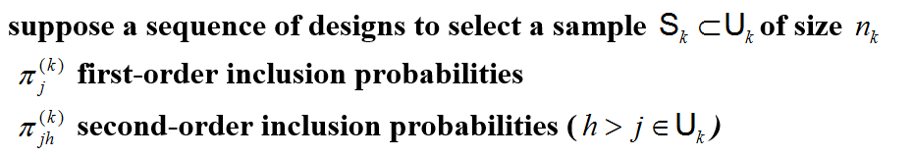



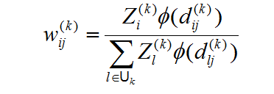


Slide 28

determine the asymptotic properties of IDW interpolator as the partitions of the study area becomes thinner and thinner
contrary to the familiar finite population asymptotic scenario in which populations are nested ….
… in our scenario the unit j of the population k is lost in the subsequent populations
j
?

Slide 29

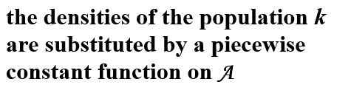

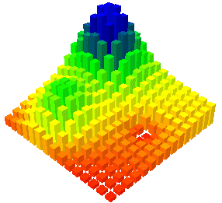
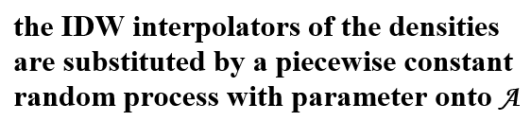
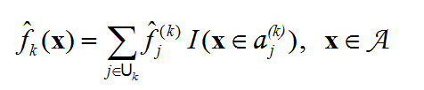

Slide 30





Slide 31
conditions ensuring DBAU&C
proofs omitted (see Fattorini et al. 2018, JASA, online)

Slide 32
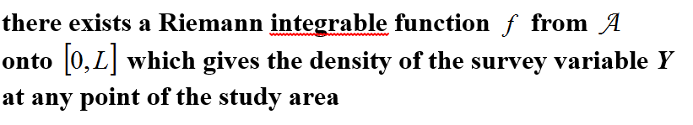
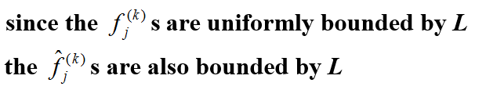
CONDITION 1
(discontinuity over regions of measure 0)
pointwise or uniform design-consistency entails
pointwise or uniform asymptotic unbiasedness

Slide 33
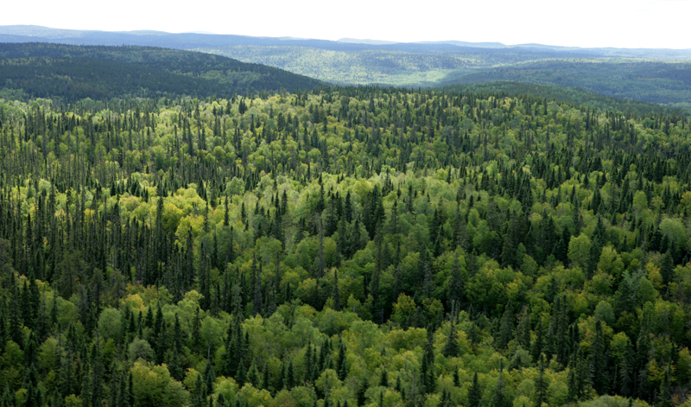
Condition 1 seems quite reasonable for many real situations:
● in real world the density of a variable is bounded
● in real world there are parts of the study region in which density changes smoothly throughout space, well approaching the theoretical condition of continuity

Slide 34
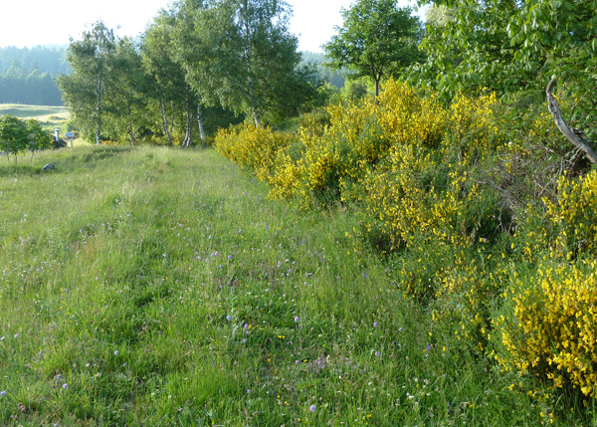
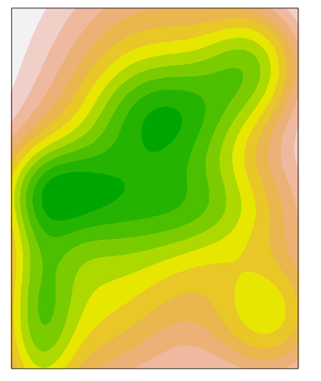
● even when density changes abruptly, that usually occurs along borders delineating sudden variations in the characteristic of the study region
● these borders may be realistically approximated by curves well approaching the theoretical condition of discontinuity over a region of zero measure

Slide 35
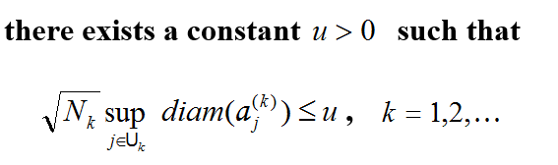

CONDITION 2
(shape regularities)
Condition 2 ensures that the spatial units not only have diameters approaching to 0 but there is no excessively elongated unit in such a way that units can be covered by smaller and smaller balls

Slide 36
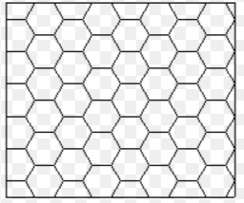
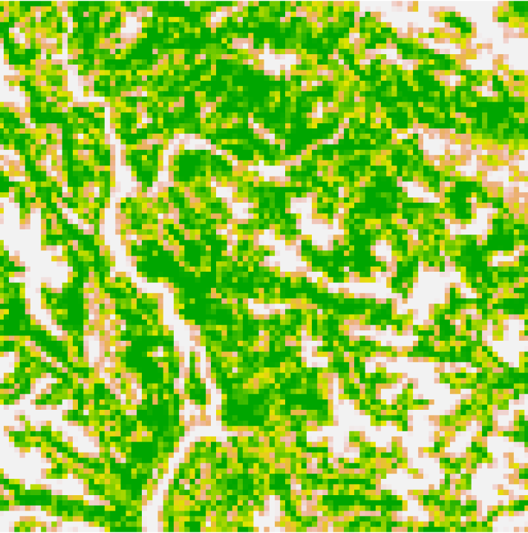
● the assumption of regularity in unit shapes frequently occurs in spatial populations
● it is fully ensured when the study area is partitioned by regular grids
● remote sensing surveys with data recorded at pixel level satisfy this requirement owing to the equal extent of pixels and their regular form

Slide 37
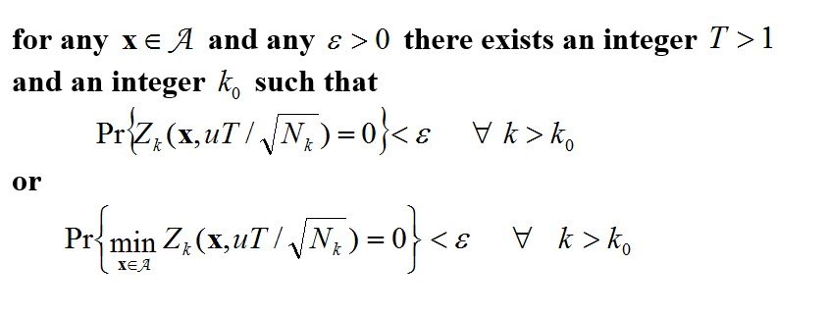
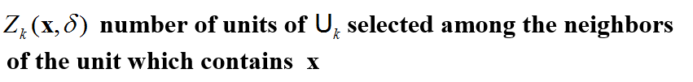
CONDITION 3
(asymptotical spatial balance)
Condition 3 concerns the design sequence and states that the probability of selecting no units “near” the unit containing x becomes definitively smaller than an arbitrary constant

Slide 38
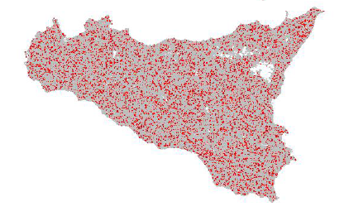
● Condition 3 ensures a spatial balance asymptotically achieved by the sampling scheme …
i.e.
… for a sufficiently large k the scheme is able to evenly spread sampled units in such a way that any unit is likely to have neighbouring units sampled

Slide 39
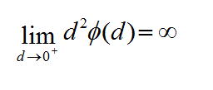


CONDITION 4
(weighting distance function)

Slide 40
How to select units for ensuring DBAU&C ??
a wide variety sampling schemes is available for sampling spatial units
the achievement of samples in which units are well spread throughout the survey area is the main target
spatial versions of familiar sampling schemes:
the one-per-stratum sampling (OPSS)
and the systematic sampling (SYS) (Breidt, 1995)
schemes explicitly constructed to work with spatial units:
the local pivotal method of first type (Grafström et al. 2012)
the spatially correlated Poisson sampling (Grafström 2012)
the doubly balanced spatial sampling (Grafström and Tillé 2013)

Slide 41
OPSS
1 partition the population into n blocks/strata of contiguous units
2 randomly select one unit per block
1
2

Slide 42
SYS
1 partition the population into n blocks/strata of contiguous units
2 randomly select one unit in a block
3 repeat it in the other blocks
1
2
3

Slide 43
suppose a constant fraction of units p>0 is selected from each population of the sequence
OPSS and SYS meet Condition 3
if f is pointwise continuous and condition 2 and 4 hold, OPSS and SYS ensure pointwise design-consistency
if f is uniformly continuous and condition 2 and 4 hold, OPSS and SYS ensure uniform design-consistency

Slide 44
for some spatial schemes it is difficult to prove Condition 3 directly
SRSWOR ????
sufficient conditions for condition 3 are given in terms of first- and second-order inclusion probabilities (as customary in some consistency theorems of finite population sampling)
SRSWOR
ensures pointwise
design-consistency
the same for stratified sampling with proportional allocation within spatial strata

Slide 45
precision estimation

Slide 46

● in practical situations, especially when making maps over large areas, the estimation has to be performed for thousands, even millions, of spatial units
● the MSE estimator should not be computationally demanding
● time-consuming resampling procedures such as bootstrap or jackknife should be avoided
● owing to Tobler’s law the density of the sampled unit nearest to unit j is likely to be a good proxy for f_{j}

Slide 47



Slide 48
simulation study

Slide 49




two densities on the unit square
uniformly continuous
discontinuous over
a set of measure 0
five populations of sizes 100, 400, 1,600, 6,400 and 25,600
grids of 10x10, 20x20, 40x40, 80x80 and 160x160 quadrats
10,000 samples independently selected by SRSWOR, OPSS and SYS
sampling fraction of 0.1

Slide 50
for each quadrat:
- absolute bias (AB)
- root mean squared error (RMSE)
- absolute bias of the root MSE estimator (ABRMSEE)
the simulation results confirmed the theoretical findings

Slide 51

D1, SYS, distance function d⁻³

Slide 52

D2, OPSS, distance function d⁻³

Slide 53
PROBLEM
● there may be situations in which the density shows many
discontinuities
● the method does not work where
density jumps
How to handle the presence of discontinuities ????

Slide 54
a way to overcome discontinuity problems:
perform the estimation at a sufficiently small spatial grain and then aggregate the resulting estimates at a greater grain

Slide 55





Slide 56

if
● the spatial interpolation is performed from a sufficiently small grain
● if the discontinuity sets can be assimilated to sets of zero measure
then
the aggregated map is uniformly design consistent irrespective of the discontinuities which may occur throughout the study region
(see Fattorini et al. 2018, JASA, Supplementary Material)

Slide 57
case study

Slide 58
AAA (Agrit Agro Ambiente) : survey performed in 2012 by the Italian Ministry of Agriculture, Food and Forestry Policies
Tuscany was tessellated by a grid of quadrats of size 6.25 ha
non-agricultural quadrats were neglected
the 277,081 cultivated quadrats constituted the population of interest
quadrats were stratified in accordance with the average altitude, percentage of cultivated land and Shannon index of land-use diversity

Slide 59
a sampling fraction of 2% was adopted within each strata to select quadrats by means of SRSWOR for a total sample of 5,593 quadrats
sampled quadrats

Slide 60


the information gathered within each sample quadrat concerned cultivation extents, quantitative and categorical features of ecological structures such as hedgerows, tree rows, stone walls, streams and isolated trees, soil characteristics such as erosion and water stagnation (Tropea et al, 2012)
ecotones
erosions

Slide 61



first knowledge about the map of
agricultural erosions

Slide 62
STEP 2

Slide 63


we have then considered situations in which:
i) the study region is a continuum of
points
ii) the survey variable is the amount of
an attribute at these points

Slide 64
most methods adopted to provide maps for continuous populations lie in the realm of model-dependent inference
the most common techniques are kriging predictors based on :
second-order stationary spatial processes
(e.g. Cressie 1993, Chapter 2,3)

Slide 65
statement of the problem

Slide 66



p
q

Slide 67



y(p)
Cordy (1993)

Slide 68




Slide 69
asymptotic framework

Slide 70






● ● ●

Slide 71





Slide 72
conditions ensuring DBAU&C
proofs omitted (see Fattorini et al. 2018, Biometrika, 105, 419-429)

Slide 73

CONDITION 1
(discontinuity over regions of measure 0)
CONDITION 2
(asymptotical spatial balance)
the probability of selecting no point “near” any point p becomes definitively smaller than an arbitrary constant

Slide 74



uniform design consistency
TSS=tessellation stratified sampling
SGS=systematic grid sampling
point-wise design consistency
URS= uniform random sampling

Slide 75



further results
Lipschitz functions arise in vegetation studies
where is used to consider the amount of forest
and ecological attributes at a pre-fixed spatial grain

Slide 76

y(p) can be the species richness, the coverage of a species or the amount of an attribute within a plot of prefixed radius centre at p
a very simple example :
3 plants on the area
y(p)= abundance of plants within a plot of this size
centered at p
y(p) is a piecewise
constant (Lipschitz) function with jumps at the edges of plots

Slide 77

in vegetation maps the resulting surfaces are costant for all the point p that are centres of plots containing the same set of units and change along plot borders of measure 0
the more the units, the more
the jumps (discontinuities)
tree volume within plot of radius 10 m in a forest - San Martino di Castrozza
(northeastern Italy, southern Alpine area)

Slide 78
precision estimation

Slide 79



Slide 80
simulation study

Slide 81


two surfaces on the unit square
S1
uniformly continuous
S2
discontinuous over
a set of measure 0
samples of sizes 25, 100, 225, 400
10,000 samples independently selected by URS, TSS and SGS
estimation performed on the 10,000 nodes of the
equally spaced 100x100 grid

Slide 82
for each node:
- absolute bias (AB)
- root mean squared error (RMSE)
- absolute bias of the root MSE estimator (ABRMSEE)
the simulation results confirmed the theoretical findings

Slide 83

S1, SGS, distance function d⁻³

Slide 84

S2, TSS, distance function d⁻³

Slide 85
PROBLEM
● there may be situations in which the density shows many
discontinuities especially at small scale
● the method does not work where
the surface jumps
?

Slide 86

the consistency of the whole map is preserved if
discontinuities occur for sets of measure 0
(Assumption 1)
in the sense that

Slide 87
case study

Slide 88

estimation of coverage for holly oak (Quercus ilex) and white violet (Viola alba Besser subsp. dehnhardtii (Ten.) W. Becker) throughout the ‘Montagnola Senese’, a hilly area (up to 650 m) of about 137 km²
holly oak: tree dominating species
white violet: grass species of nature conservation importance
● sampling design: TSS adopted in the last National Italian Forest Inventory (Fattorini et al. 2006)
● n=136 quadrats of side 10 m was centered at each inventory point
● the percentage of plot covered by the two species was recorded (Chiarucci et al., 2008)

Slide 89




estimation performed at 10,691 equally spaced points
distance function d⁻³
holly oak
white violet

Slide 90
STEP 3

Slide 91


we have finally considered situations in which:
i) there is a finite population of points
scattered onto a study area
ii) the survey variable is an attribute
(mark) of these points
forthcoming
(we hope)

Slide 92
most methods adopted to provide maps for populations of marked points lie in the realm of model-dependent inference
the most common techniques are:
independently marked (or randomly labelled) point process
geostatistical (or externally) marked point processes
Karr (1986)
density-dependent marked point processes
(Lai Ping Ho and Stoyan, 2010)

Slide 93
statement of the problem

Slide 94


p_{j}
p_{h}

Slide 95

y_{j}

Slide 96
asymptotic framework

Slide 97






and so on ….
nested population of increasing sizes (the familiar finite population asymptotic scenario)

Slide 98




Slide 99
conditions ensuring DBAU&C
proofs omitted (Fattorini et al. 2018, submitted)

Slide 100







CONDITION 1
CONDITION 2
regularity in the enlargements of populations
…
…

Slide 101

CONDITION 3
(asymptotical spatial balance)
the probability of selecting no point “near” any point p_{j} becomes definitively smaller than an arbitrary constant

Slide 102





Reinforcing CONDITION 2
point-wise consistency holds under:
SRSWOR
stratified with proportional allocation
3P sampling

Slide 103





… furtherly reinforcing CONDITION 2

Slide 104
precision estimation

Slide 105



Slide 106
simulation study

Slide 107
two functions on the unit square
for generating marks
uniformly continuous
F1
discontinuous over
a set of measure 0
F2
3 nested populations of N=1000, 5000, 10000 points
points located in the unit square in accordance with
regular (RE)
random (RA)
trended (TR)
clustered (CL)
spatial pattern

Slide 108












regular
random
F1
clustered
trended
N
1000
5000
10000

Slide 109












regular
random
F2
clustered
trended
N
1000
5000
10000

Slide 110

10,000 samples of size n=N/10 independently selected by SRSWOR
stratified sampling with proportional allocation
doubly balanced spatial sampling (Grafström and Tillé 2013)
for each point:
- absolute bias (AB)
- root mean squared error (RMSE)
- absolute bias of the root MSE estimator (ABRMSEE)
the simulation results confirmed the theoretical findings: best results achieved with TR and CL patterns, doubly balanced sampling was the best

Slide 111
case study

Slide 112



estimation of tree heights in a semi-natural mixed oak-hornbeam forest of size 70x140 m² in the province of Mantova (North Italy)
the N = 510 trees were visited by a crew of experts to give a prediction of tree height for each tree
a sample of n = 54 trees was selected by 3P sampling and their heights were measured
tree height estimation was performed for all trees in the forest by using
the IDW estimator with ϕ(d) = d³

Slide 113
CONCLUSIONS

Slide 114
our design-based approach to spatial mapping avoids the massive modelling involved in model-based approaches, i.e. the use of spatial models on lattices required for finite populations of spatial units (e.g. Cressie, Chapter 6), the use of second-order stationary spatial processes required for continuous populations (e.g. Cressie, Chapter 3) and the marked point processes in the plane required for finite populations of marked points (e.g. Cressie, Chapter 8)
design-based asymptotic unbiasedness and consistency of the resulting maps are achieved exploiting different asymptotic scenarios for the three cases, at the cost of some assumptions
i) some forms of smoothness of the survey variables throughout the study area
ii) some sort of regularities that are necessary in the case of finite populations such as regularities in the shape of spatial units or regularities in the enlargements of the point populations
iii) the use of asymptotically balanced spatial sampling schemes
iv) the use of distance functions sharing some mathematical properties
note that: iii) is satisfied by the more common sampling schemes adopted in spatial surveys and iv) can be readily ensured by the user

Slide 115
FUTURE WORKS

Slide 116


1
there is a tremendous opportunity to both reduce costs and improve the precision of estimates taking advantage of the increasing availability of various inexpensive auxiliary data derived from remote sensing sources (Opsomer et al, JASA, 2007)
interpolation exploiting auxiliary
information – design-based counterpart of regression kriging
2
the resulting maps actually constitute pseudo-populations
pseudo-population bootstrap for design-based inference on the parameters of spatial phenomena

Slide 117
3
the IDW interpolator may not be the unique criterion
condition on weights under which consistency occurs
generalizing the spatial interpolator estimator
4
estimation in small portion of the study area where the sample
information is scarce
design-based small area estimation

Slide 118
References
Breidt FJ (1995) Markov chain designs for one-per-stratum sampling. Survey Methodology 21: 63–70.
Bruno F, Cocchi D, Vagheggini A (2013) Finite population properties of individual predictors based on spatial pattern. Environmental and Ecological Statistics 20: 467-494.
Chiarucci A, Bacaro G, Rocchini D (2008). Quantifying plant species diversity in a Natura 2000 network:Old ideas and new proposals. Biological Conservation 141: 2608–2615.
Cordy CB (1993) An extension of the Horvitz-Thompson theorem to point sampling from a continuous universe, Statistics & Probability Letters 18: 353-362
Cressie N (1993) Statistics for spatial data. Wiley, New York.
Fattorini L, Marcheselli M, Pisani C( 2006) A three-phase sampling strategy for large-scale multiresource forest inventories. Journal of Agricultural, Biological and Environmental Statistics 11:1-21.
Fattorini L, Marcheselli M, Pratelli L (2018) Design-based maps for finite populations of spatial units. Journal of the American Statistical Association, online first
Fattorini L, Marcheselli M, Pisani C, Pratelli L (2018) Design-based maps for continuous spatial populations. Biometrika 105: 419-429
Fattorini L, Marcheselli M, Pisani C, Pratelli L (2018) Design-based mapping for finite populations of marked points. Submitted
Grafström A (2012) Spatial correlated Poisson sampling. Journal of Statistical Planning and Inference 142: 139–147.
Grafström A, Lundström NLP, Schelin L (2012) Spatially balanced sampling through the pivotal method. Biometrics 68: 514–520.
Grafström A, Tillé Y (2013) Doubly balanced spatial sampling with spreading and restitution of auxiliary totals. Environmetrics 24: 120–131.
Karr AF (1986) Inference for stationary random fields given Poisson samples. Advances in Applied Probability 18: 406-422.
Lai Ping Ho, Stoyan D (2010) Modelling marked point patterns by intensity-marked Cox processes. Statistics and Probability Letters 78: 1194-1199.
Tobler WR (1970) A computer movie simulating urban growth in the Detroit region. Economic Geography 46: 234-240.
Tropea F, De Meo L, Fattorini L (2012) Agro-environmental surveys supported by spatial information from integrated administration and control system (IACS). In “Geomatics in support of The Common Agricultural Policy”, D Fasbender, K Taşdemir, P Loudjani, V Angileri, C Lucau, P Milenov, W Devros, R De Kok, S Lemajic, A Tarko, P Pizziol Eds. Publication Office of Europèean Union. Luxembourg
Vagheggini A, Bruno F, Cocchi D (2016) A competitive design-based spatial predictor. Environmetrics, 27:454-465.

Slide 119
THANKS

Slide 120
drawbacks and merits of the two approaches are well delineated in statistical literature:
Smith 1994, 2001
Gregoire 1998
Thompson 2002
Schreuder et al. 1993
we just remember that
“Design-based inference is objective, nobody can challenge that the sample was really selected according to the given sampling design. The probability distribution associated with the design is real, not modelled or assumed” Särndal et al. (1992, p. 21)

Slide 121




